Slide 1
Concert Calendar
Jae Hoon Kim
Neil McGuire
Konstantin Nomerov

Slide 2
Contents
Overview
Manage Concert Information (Cloudmine)
Search (Client)
Calendar (Client)

Slide 3
Overview
Overview
Cloudmine
Search
Calendar
This application allows users to track artists by name as well as see a list all upcoming concerts for the next 5 days.
Concert information used is loaded from http://www.xpn.org/events/concert-calendar.

Slide 4
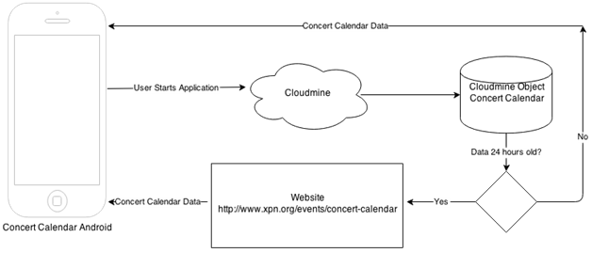
Overview
Overview
Cloudmine
Search
Calendar

Slide 5
Manage Concert Information
Overview
Cloudmine
Search
Calendar
Project utilizes https://cloudmine.me object storage to store concert information. Running application for the first time parses and stores concert data into Cloudmine.
Subsequent runs will load data from Cloudmine, thereby skipping the parsing step and speeding up the application.
Before loading concert data from Cloudmine, Concert Tracker will check if it is less than 24 hours old.
Running application more than 24 hours after previous run will once again download, parse and store fresh data from www.xpn.org into Cloudmine.

Slide 6
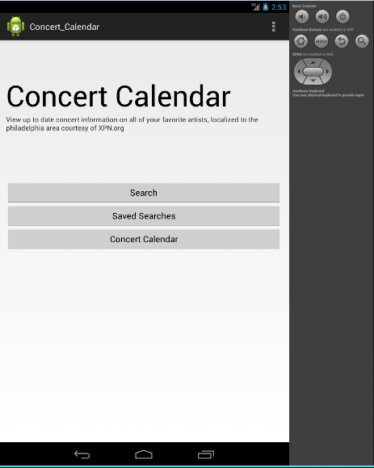
Client
Overview
Cloudmine
Search
Calendar
Notes:
Initial Screen contains 3 buttons, Search, Saved Searches, and Concert Calendar. To exit application press android back button.
Search Button - Search concerts by artist
Saved Searches - Loads previously saved searches
Concert Calendar Button - View all artists performing in the next 5 days

Slide 7
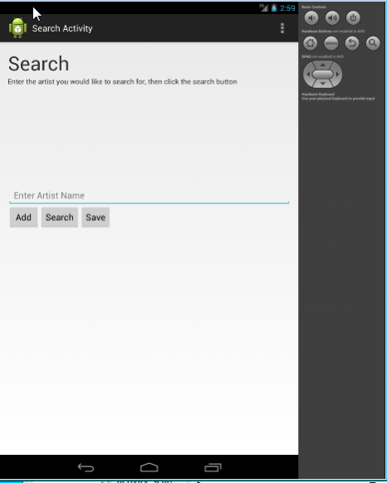
Client
Overview
Cloudmine
Search
Calendar
Notes:
Search Screen contains 3 buttons, Add, Search and Save. Artist name should be typed in provided space.
Add Button - adds artist name to list of artists to search. Names of artists will appear at the bottom.
Search Button - runs search, takes to search result screen.
Save Button - saves current search.
Note that searching for artists without first adding search string will produce no results. To go to previous screen press android back button.

Slide 8
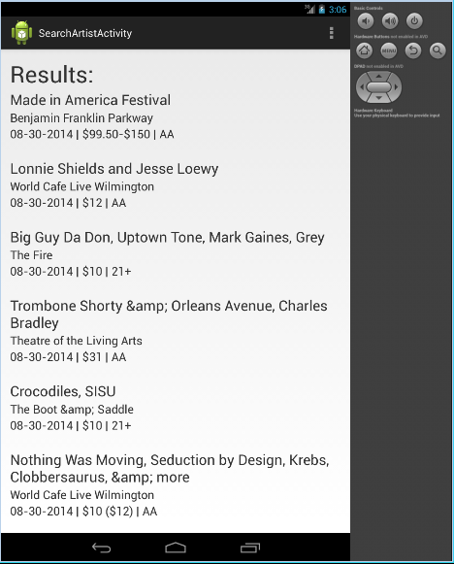
Client
Overview
Cloudmine
Search
Calendar
Notes:
This is an example of search Results Screen. Results can be scrolled up and down. Each concert is visibly separated by space.
On top of each concert appears artist and band . For long names this may appear as two lines.
Next line shows venue, location.
Last line shows concert date, price, and age restrictions.
Press android back button to go back to search screen.

Slide 9
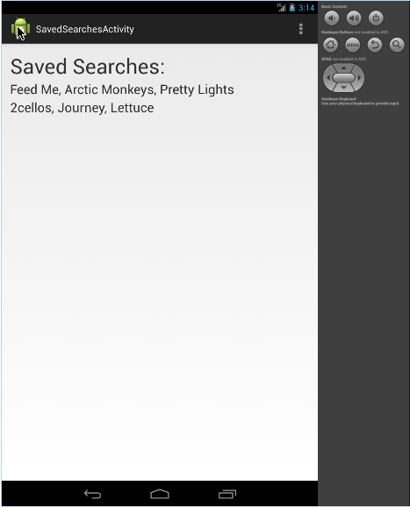
Client
Overview
Cloudmine
Search
Calendar
Notes:
Pressing Saved Searches from Initial Screen will list all artists whose searches have been saved. Press android back button to go back to Initial Screen.

Slide 10
Client
Overview
Cloudmine
Search
Calendar

Slide 11
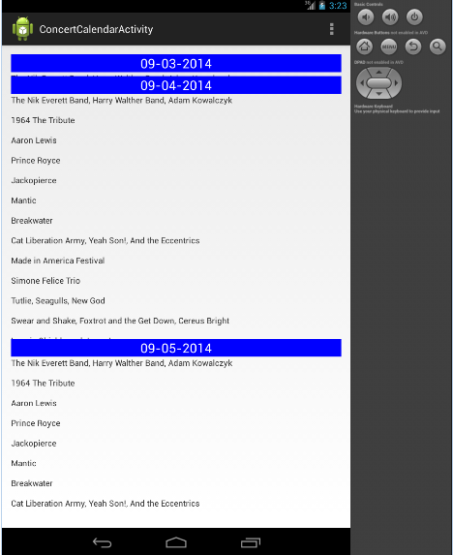
Client
Overview
Cloudmine
Search
Calendar
Notes:
Concert Calendar screen shows all artists performing in the next 5 days. It is accessed by pressing Concert Calendar button in Initial Screen.
Note that days when no artists are performing are hidden. Each day is separate and is scrollable up and down. To go back to Initial Screen press android back button.

Slide 12
Client
Overview
Cloudmine
Search
Calendar

Slide 13
Q & A

